Slide 1
DeFi Lending Systems
CS251 Fall 2021
(cs251.stanford.edu)
Dan Boneh
HW#3 posted later tonight. Please fill out the feedback form on Ed.

Slide 2

A few words on WorldCoin
By popular request …

Slide 3
Where we are in the course
How consensus protocols work
Bitcoin: the UTXO model, and the Bitcoin scripting language
Ethereum (the blockchain computer): the EVM and Solidity
Current topic: decentralized finance
on-chain: exchanges, stablecoins, today: lending
Next: privacy on the blockchain, scaling the blockchain, and interoperability across blockchains

Slide 4
DeFi Lending Protocols
Goal: explain how decentralized lending works
This is not investment or financial advice

Slide 5
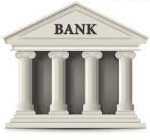
The role of banks in the economy
Banks bring together lenders and borrowers
deposit assets
borrow
deposit interest
borrow interest
bank spread (borrow interest – deposit interest)
Notes:
Banks collect assets from depositors and deploys them where they are needed.

Slide 6
The role of banks in the economy
Alice will get her deposit back either way
Bank assumes the risk of Bob defaulting
deposit assets
borrow
withdraw deposit
repay loan
bank spread (borrow interest – deposit interest)

Slide 7
Crypto: CeFi lending (e.g., Blockfi, Nexo, …)
Same as with a traditional bank:
CeFi
deposit ETH
Borrow ETH
deposit interest
borrow interest
Centralized Finance
institution
Alice gives her assets to the CeFi institution to lend out to Bob

Slide 8
The role of collateral
(1 ETH = 100 UNI)
CeFi’s concern: what if Bob defaults on loan?
⟹ CeFi will absorb the loss
Solution: require Bob to lock up collateral
collateral
CeFi
deposit 500 UNI
debt position:
Borrow 1 ETH
+ 500 UNI
− 1 ETH
interest deducted from collateral
over collateralized loan

Slide 9
The role of collateral
(1 ETH = 100 UNI)
Several things can happen next:
Bob repays loan
×
repay 1 ETH
debt position:
CeFi
+ 500 UNI
− 1 ETH
redeem UNI collateral
(minus interest)

Slide 10
The role of collateral
(1 ETH = 100 UNI)
Several things can happen next:
Bob repays loan
Bob defaults on loan
Ok, I’ll keep (100 + penalty) UNI
×
I can’t repay 1 ETH
debt position:
CeFi
+ 500 UNI
− 1 ETH
redeem remaining UNI collateral
(400 − interest − penalty) UNI

Slide 11
The role of collateral
(1 ETH = 400 UNI)
Several things can happen next:
Bob repays loan
Bob defaults on loan
Liquidation: value of loan increases relative to collateral
I need to liquidate your collateral
(and charge a penalty)
debt position:
CeFi
+ 500 UNI
− 1 ETH
+ 100 UNI
− 0 ETH
lender needs to liquidate before value(debt) > value(collateral)

Slide 12
Terminology
Collateral: assets that serve as a security deposit
Over-collateralization: borrower has to provide value(collateral) > value(loan)
Under-collateralization: value(collateral) < value(loan)
Liquidation: if value(debt) > 0.6 × value(collateral)
then collateral is liquidated until inequality flips
(liquidation reduces both sides of the inequality)
collateral factor
Notes:
Liquidation ratio gives lender time to liquidate before funds are at risk.

Slide 13
Collateral factor
CollateralFactor ∈ [0,1]
Max value that can be borrowed using this collateral
High volatility asset ⟹ low collateral factor
Relatively stable asset ⟹ higher collateral factor
Examples: (on Compound)
ETH, DAI: 75%, UNI: 60%, YFI: 35%
Notes:
https://compound.finance/markets/ETH

Slide 14
Health of a debt position
(in ETH)
helath < 1 ⟹ triggers liquidation until (health ≥ 1)

Slide 15
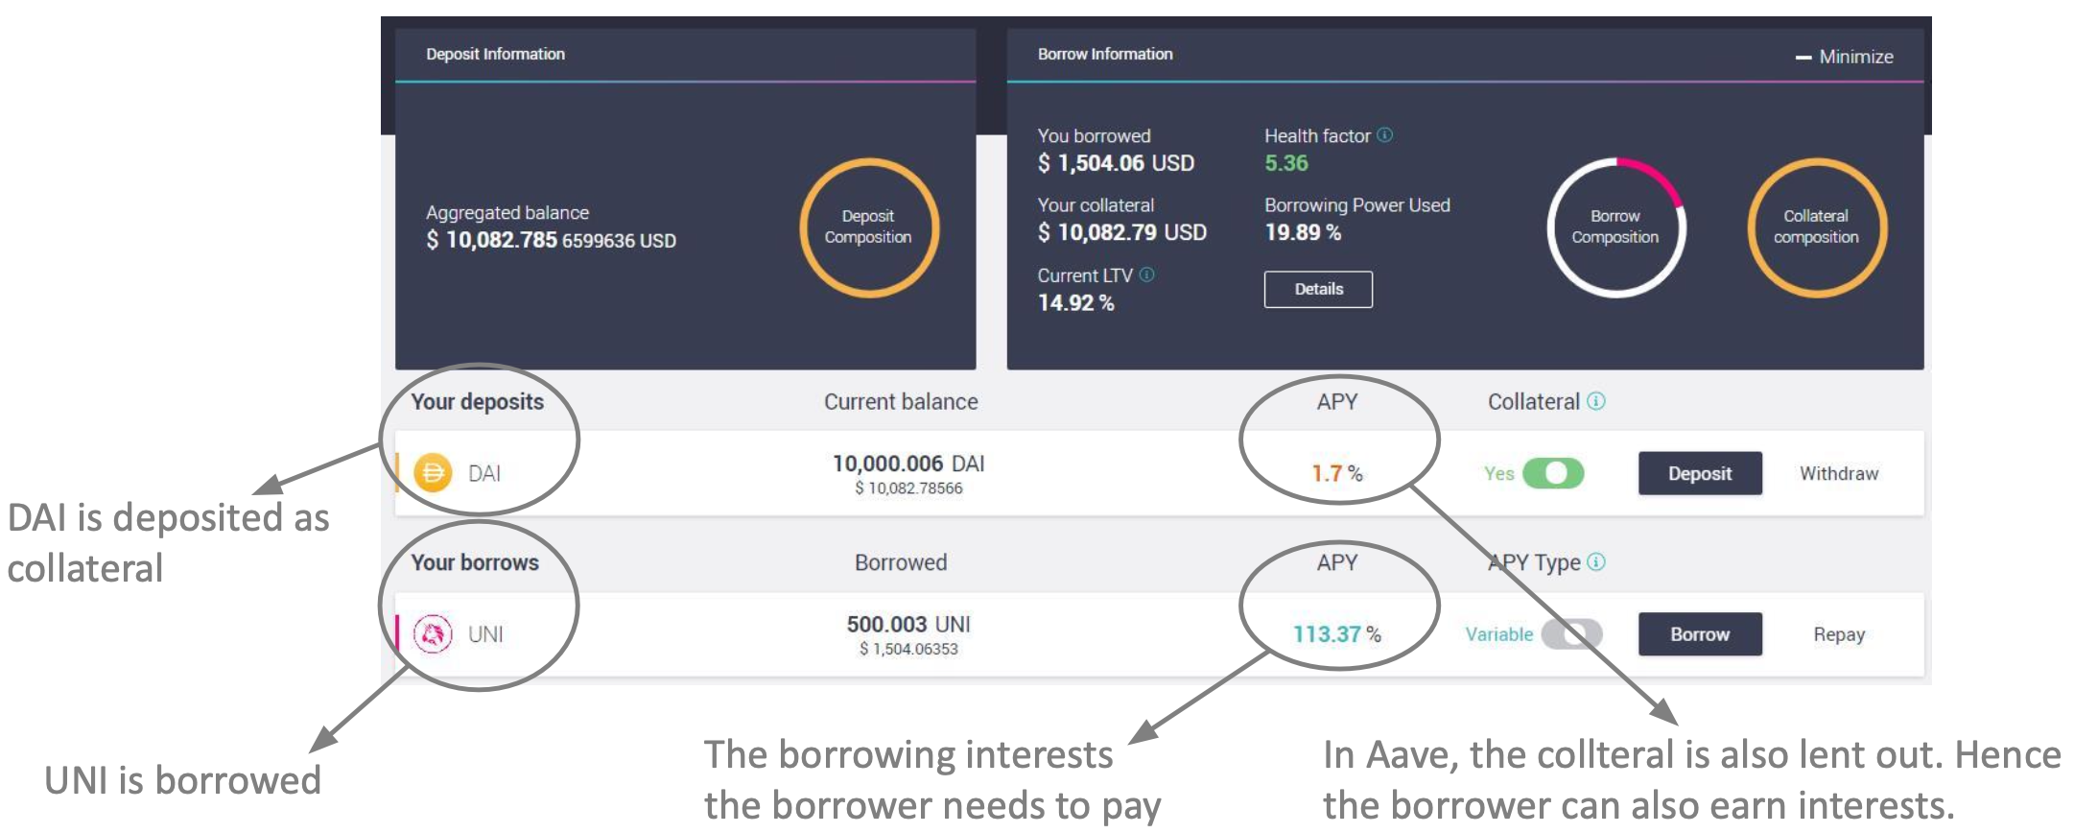
Example: Aave dashboard (a DeFi lending Dapp)
actions
Credit: Arthur Gervais

Slide 16
Why borrow ETH?
If Bob has collateral, why can’t he just buy ETH?
Bob may need ETH (e.g., to buy in-game Axies), but he might not want to sell his collateral (e.g., an NFT)
As an investment strategy: using UNI to borrow ETH gives Bob exposure to both

Slide 17
The problem with CeFi lending
Users must trust the CeFi institution:
Not to get hacked, steal assets, or miscalculate
This is why traditional finance is regulated
Interest payments go to the exchange, not liquidity provider Alice
CeFi fully controls spread (borrow interest – deposit interest)

Slide 18
DeFi Lending
Can we build an on-chain lending Dapp?
⟹ no central trusted parties
⟹ code available on Ethereum for inspection

Slide 19
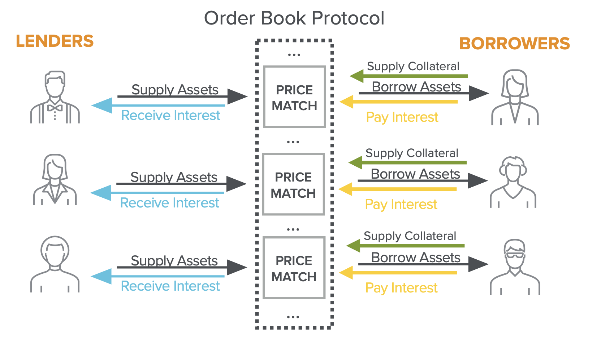
A first idea: an order book Dapp
(large institutions, banks)
Credit: Eddy Lazzarin

Slide 20
Challenges
Computationally expensive: matching borrowers to lenders requires many transactions per person (post a bid, retract if the market changes, repeat)
Concentrated risk: lenders are exposed to their direct counterparty defaulting
Complex withdrawal: a lender must wait for their counter-parties to repay their debts

Slide 21
A better approach: liquidity pools
Over-collateralized lending: Compound and Aave
supply assets
DAI
ETH
supply assets
supply assets
UNI
AXS
borrowers
Liquidity Providers
(earn interest)
Compound/Aave Dapps gather liquidity

Slide 22
Example: Compound cTokens
4 markets
Liquidity Provider
supply assets
DAI
ETH
10 ETH, 1000 DAI, 500 UNI
mints cTokens for Alice (ERC-20)
UNI
AXS
X cETH, Y cDAI, Z cUNI
Compound
Value of X, Y, Z is determined by an exchange rate:
Token to cToken exchange rate is calculated every block
Notes:
Aave aTokens are one-to-one with underlying asset. Pay interest in aTokens to each owner’s address.

Slide 23
Borrowers
4 markets
supply assets to any market
DAI
ETH
ETH
get cTokens
UNI
AXS
I want to borrow ETH
Bob’s cTokens are locked up as collateral
Compound
Compound sends ETH to Bob
Bob’s accrued interest increases ETH/cETH exchange rate
⟹ benefit cETH token holders (ETH liquidity providers)
Notes:
cETH token holders make a profit

Slide 24
The exchange rate
Consider the ETH marker:
Supplying ETH: adds to UnderlyingBalance_{ETH}
Borrowing ETH: adds to totalBorrowBalance_{ETH}
Interest: added repeatedly to totalBorrowBalance_{ETH}
UnderlyingBalance_{ETH} + totalBorrowBalance_{ETH} − reserve_{ETH}
ExchangeRate_{ETH/cETH} =
cTokenSupply_{ETH}
⟹ As totalBorrowBalance increases so does ExchangeRate
Notes:
The more lending and interest payment happen, the higher totalBorrowBalance.
As UnderlyingBalance_{ETH} increases, so does cTokenSupply_{ETH} so overall ExchangeRate decreases.
Need to check the exact mechanism by which interest is added to totalBorrowBalance. Likely by burning collateral cTokens and increasing totalBorrowBalance by a commensurate amount.

Slide 25
The interest rate: constantly updates
Key idea: determined by demand for asset vs. asset market size
Utilization ratio: U_{ETH} =
totalBorrowBalance_{ETH}
availableBalance_{ETH} + totalBorrowBalance_{ETH}
higher totalBorrowBalance, or
lower availableBalance in contract
higher U_{ETH} ∈ [0,1]
interestRate_{ETH} = BaseRate_{ETH} + U_{ETH}×slope_{ETH}
Notes:
Interest increases with U_{ETH}
Two extremes: totalBorrowBalance = 0 then U = 0, availableBalance = 0 then U = 1.

Slide 26
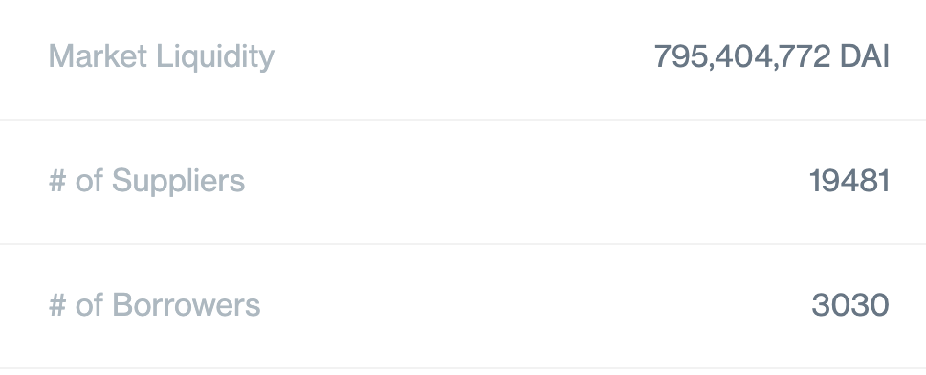
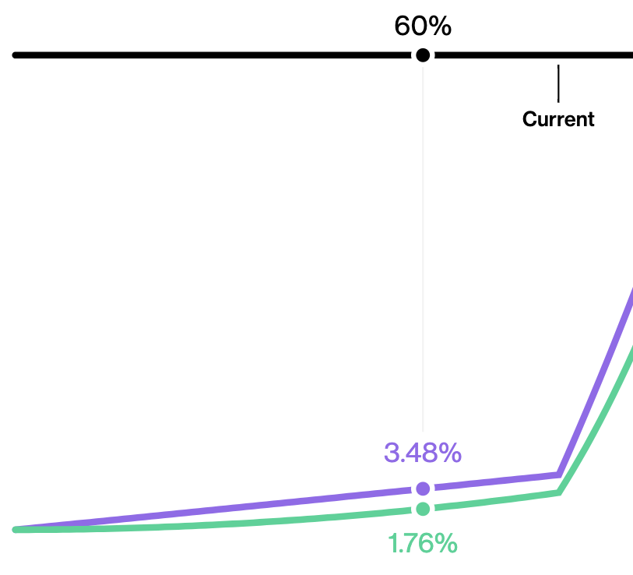
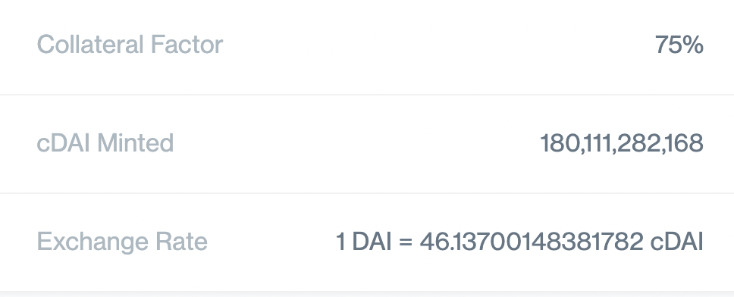
Example: Compound DAI market
utilization
(79.95%)
borrow APY at 60% utilization
deposit APY at 60% utilization
(Oct. 2021)
Notes:
https://compound.finance/markets/DAI
Exchange rate starts at 1 DAI = 50 cDAI. Gain since start: 8.3% (50/46.137) - 1

Slide 27
Liquidation: debt > BorrowCapacity
If user’s health < 1 the anyone can call:
liquidate(borrower, CollateralAsset, BorrowAsset, uint amount)
address of borrower
being liquidated
Liquidator wants cTokens in this asset
(e.g., cDAI)
Liquidator is providing this asset
(e.g., ETH)
This function transfers liquidator’s ETH into ETH market, and gives the liquidator cDAI from user’s collateral
Notes:
Reduce’s the exposure of the ETH market, and pays liquidator in cDAI.
The # of cDAI liquidated is determined by the current ETH/DAI exchange rate, including a discount for the liquidator.

Slide 28
Liquidation: debt > BorrowCapacity
If user’s health < 1 the anyone can call:
Liquidator is repaying the user’s ETH debt and getting the user’s cDAI [at a discounted exchange rate -- penalty for user]
liquidate(borrower, CollateralAsset, BorrowAsset, uint amount)
address of borrower
being liquidated
Liquidator wants cTokens in this asset
(e.g., cDAI)
Liquidator is providing this asset
(e.g., ETH)
This function transfers liquidator’s ETH into ETH market, and gives the liquidator cDAI from user’s collateral
Notes:
Reduce’s the exposure of the ETH market, and pays liquidator in cDAI.
The # of cDAI liquidated is determined by the current ETH/DAI exchange rate, including a discount for the liquidator.
Compound liquidation discount on the exchange rate is 8%.

Slide 29
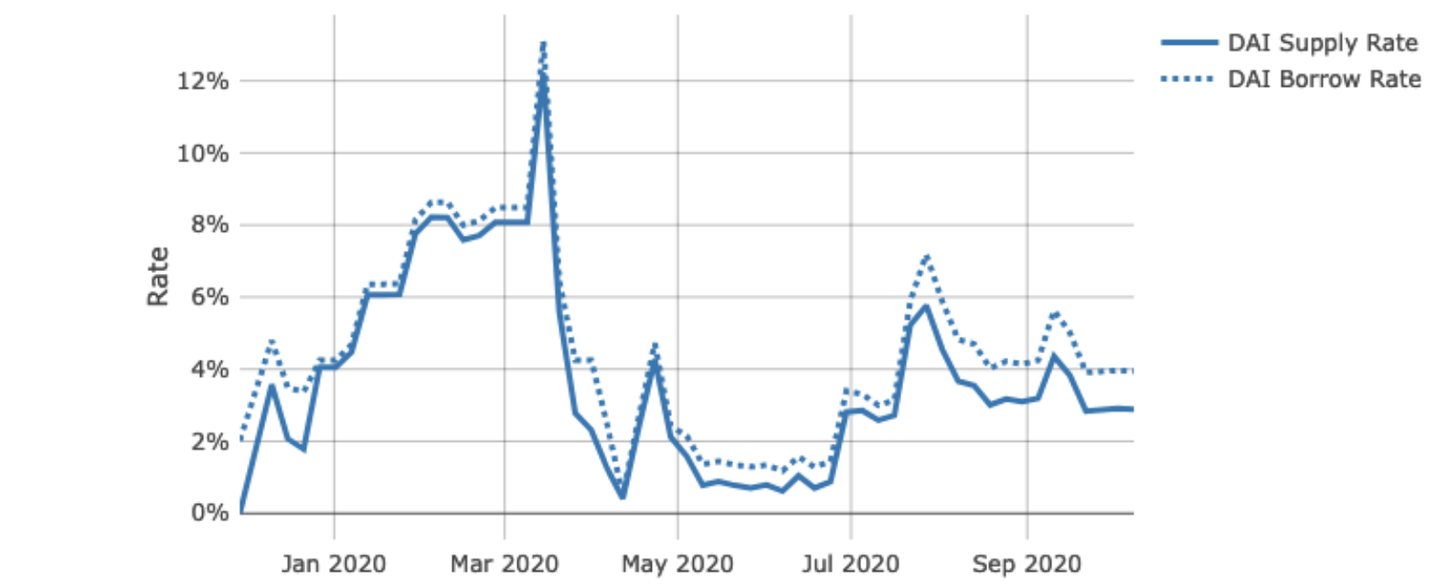
What is liquidation risk?
Historical DAI interest rate on Compound (APY):
Demand for DAI spikes
⟹ price of DAI spikes
⟹ user’s debt shoots up
⟹ user’s health drops
⟹ liquidation …
To use Compound borrower must constantly monitor APY and quickly repay loans if APY goes too high (can be automated)
Notes:
Several automation services are available: https://medium.com/defi-saver/introducing-compound-automation-automatic-liquidation-protection-for-compound-is-now-live-6f5e2d22c9e0

Slide 30
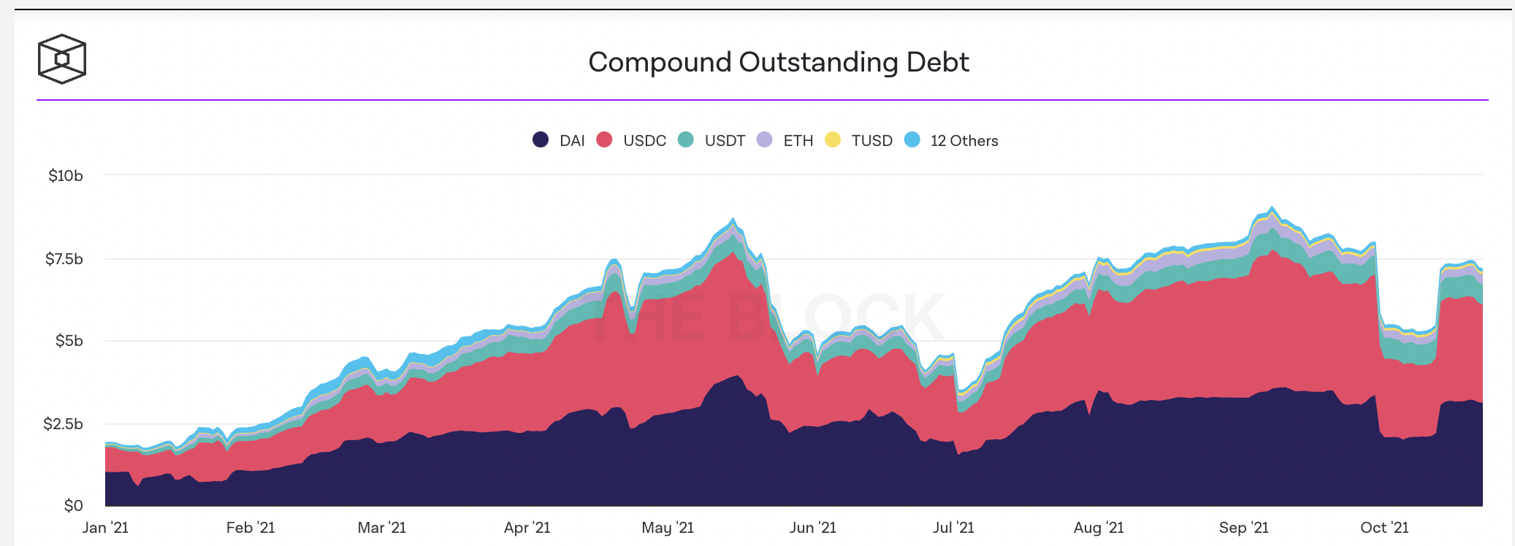
Summary & stats
Liquidity providers can earn interest on their assets
DeFi lending is being used quite a bit:
Notes:
https://www.theblockcrypto.com/data/decentralized-finance/cryptocurrency-lending

Slide 31
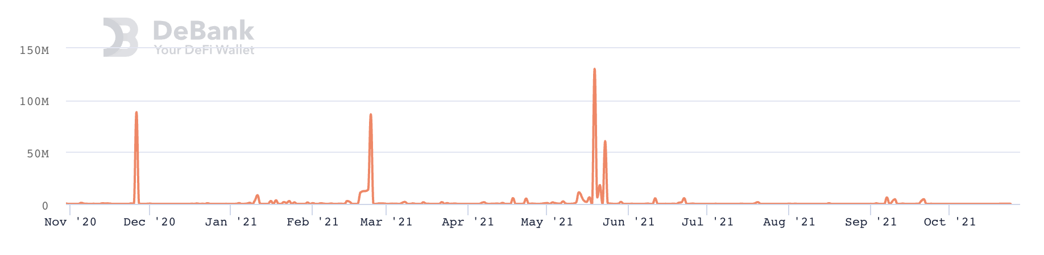
Summary & stats
Compound liquidation statistics:
Caused by collateral price drops or debt APY spikes
Notes:
https://debank.com/projects/compound?chart_date=1Y&mode=stats

Slide 32
Flash loans

Slide 33
What is a flash loan?
A flash loan is taken and repaid in a single transaction
⟹ zero risk for lender ⟹ borrower needs no collateral
Initiating contract
borrow $1M
Flash Loan Provider
do stuff with funds
return funds
(Tx is valid only if funds are returned in same Tx)
“Attacking the DeFi Ecosystem with Flash Loans for Fun and Profit”

Slide 34
Use cases
Risk free arbitrage
Collateral swap
DeFi attacks: price oracle manipulation
⋮

Slide 35
Risk free arbitrage
Alice finds a USDC/DAI price difference in two pools
Aave (flash loan provider)
Flash loan 1M USDC
Repay 1M USDC loan
Uniswap
USDC⇾DAI
1M USDC
1.002M DAI
Curve
DAI⇾USDC
1.002M DAI
1.001M USDC
1USDC = 1.002DAI
1USDC = 1.001DAI
keep 0.001M USDC
All in a single transaction

Slide 36
Collateral swap
Alice @Compound
Alice @Compound
-1000 DAI
+1 cETH
Take 1000 DAI flash loan
Repay 1000 DAI debt
Redeem 1 cETH
Swap 1 cETH for 3000 cUSDC
Deposit 3000 cUSDC as collateral
Borrow 1000 DAI
Repay 1000 DAI flash loan
-1000 DAI
+3000 cUSDC
borrowed DAI using ETH as collateral
borrowed DAI using USDC as collateral
(a single Ethereum transaction)
Notes:
Alice is worried ETH value will fall and she will be liquidated. Wants to swap ETH collateral for equivalent USDC.

Slide 37
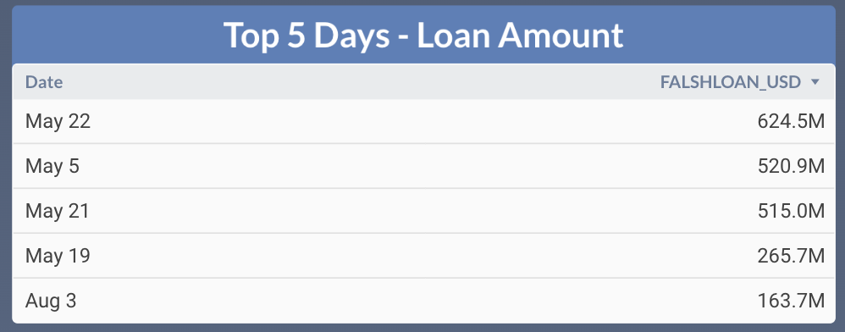
Flash loans amounts on Aave (in 2021)

Slide 38
END OF LECTURE
Next lecture: U.S. blockchain regulations

Slide 39


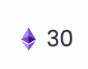
Recall the four application areas
Finance (DeFi):
new financial instruments, exchanges, lending, …
Managing digital assets (NFTs)
Games, metaverse: assets managed on chain
DAOs: decentralized organizations
CryptoPunk #2890

Slide 40


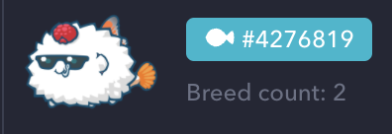
Digital assets (NFTs)
Example digital assets: (ERC-721)
Digital art: opensea, foundation
Collector items: NBA top shots
Game items: horses (zed.run), axies, …
Metaverse: plots in a virtual land
Why manage on a blockchain? Why not manage centrally?
Blockchain ensures long-term ownership, until sale.
Provides a trusted record of provenance (forgeries are evident)
#8857
NBA
Notes:
Opensea: Tx volume of $3.4 billion in August.
Importance of digital assets will likely grow over time.

Slide 41
ERC-721 (subset)
mapping (uint256 => address) internal idToOwner;
function safeTransferFrom( address _from, address _to, uint256 _tokenId, bytes data)
function approve(address _approved, uint256 _tokenId)
function setApprovalForAll(address _operator, bool _approved)
function ownerOf(uint256 _tokenId) returns (address);
Notes:
idToOwner: maps token ID to owner address
safeTransferFrom: transfers tokenId from one owner address to another, and records bytes
Approve: allow address to manager tokenId
setApprovalForAll: allow operator to manage all of msg.sender’s tokens (_approved=false to revoke)
ownerOf: who is the owner of tokenId

Slide 42
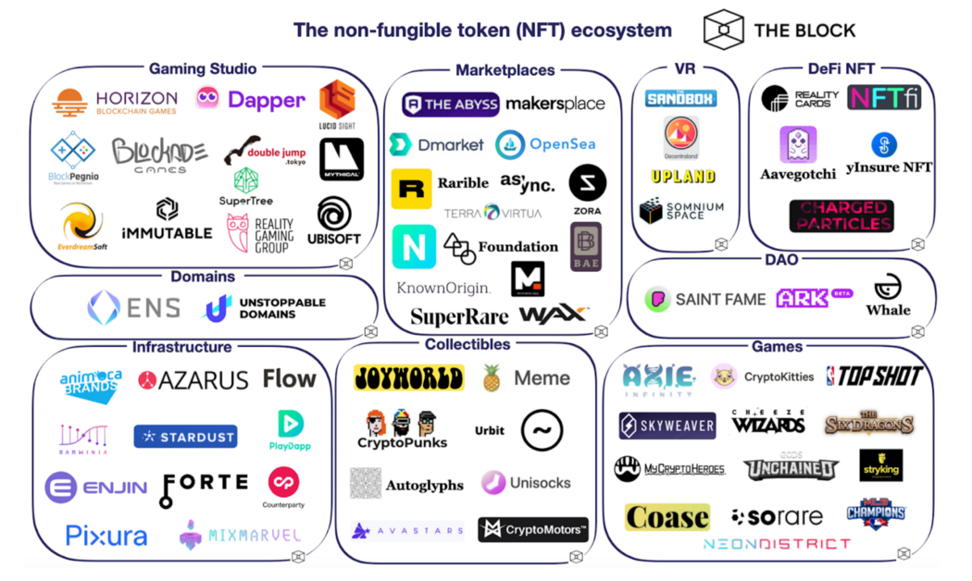
(Sep. 2020, out of date)

Slide 43
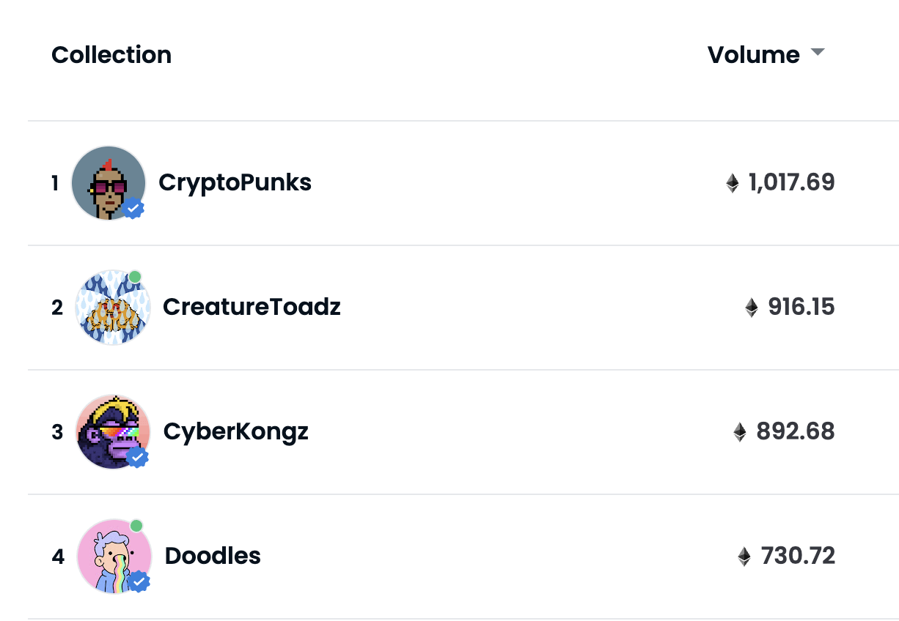
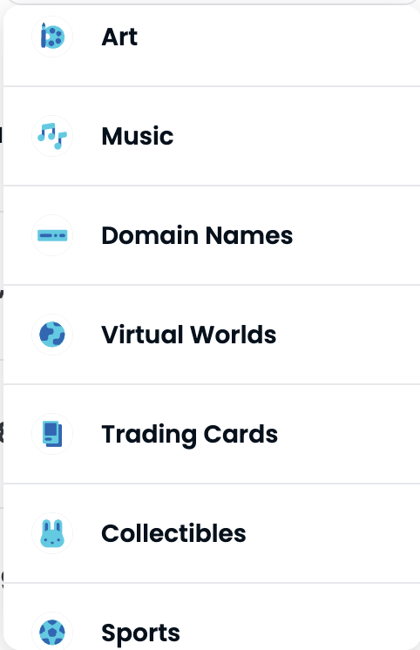
OpenSea 24h volume
OpenSea categories

Slide 44







Example: CryptoPunks (generated in 2017)
10,000 total CryptoPunks. Managed by contract at Ethereum address 0xb47e3cd8DF8… (250 lines of solidity)
visa
#7610
buy offer
sold!
sell offer
https://www.larvalabs.com/cryptopunks/details/7610
Notes:
24x24 picture. Not ERC-721
Snapshot of offers and sales.

Slide 45
digital assets: where is this going?
What does ownership mean?
Who receives royalties on item: owner or creator?
Where is item stored? Where can it be displayed?
… depends on NFT code.
NFTs and DeFi: asset-based DeFi:
Use NFT as collateral in loans
Fractional ownership of NFT assets
NFT-based futures market
Notes:
Royalties: ad revenues on display of item.

Slide 46


Decentralized orgs (DAO)
What is a DAO?
A Dapp deployed on-chain at a specific address
Anyone (globally) can send funds to DAO treasury
Anyone can submit a proposal to DAO
⟹ participants vote
Examples:
art collector DAOs, charity DAOs, investment DAOs
Notes:
Movie studio DAO: participants decide what movie scripts to fund, and then share in profits from movie.

Slide 47
Examples
Creating a DAO is quite simple: syndicate.io
… cheaper than creating a real-world U.S. partnership
Example DAOs:
PleasrDAO: invests in digital art (NFTs),
30 pieces collected, treasury of $26M
Gitcoin: DAO to fund open source projects ($36M sent)
Investment DAOs: many
Regulation? Next lecture …

